Slide 1
(Escherichia coli Infections) Colibacillosis
Colibacillosis is a localized or systemic infection caused by avian pathogenic Escherichia coli (APEC). ,
including as acute fatal septicemia, subacute pericarditis, airsacculitis, salpingitis, peritonitis, cellulitis, omphalitis and yolk sac infection .
Most, if not all avian species, are susceptible to colibacillosis.Clinical disease is reported most often in chickens, turkeys, and ducks.

Slide 3
Etiology
Avian pathogenic E. coli, is a gram-negative, non-spore-forming bacillus. Somatic (O) , capsular (K) antigens are often used to designate serotypes.
. Most of the strains are motile.

Slide 4
Transmission
E. coli is present in the intestinal tracts of most animals and shed in the feces, often in high numbers.
Direct or indirect contact with other animals or feces can introduce new strains
into the poultry flock.

Slide 5
Vectors like darkling beetle ,flies, insects, mites , rats and wild birds can play a role in the spreading of Escherichia coli .
Escherichia coli can be transmitted either horizontally, directly or indirectly, or vertically from breeders carrying the organism in their reproductive tract to their progeny

Slide 6
The respiratory route seems to be also very important for the appearance of clinical disease,
while the oviduct can also be another route of infection for Escherichia coli concerning layers and breeders

Slide 7
Predisposing factors
Immunocompromised bird
After respiratory stress caused by Mycoplasma  Infectious Bronchitis (IB)  New Castle Disease (ND)  Environmental Stress like: high temp. & humidity, high concentration ammonia gas

Slide 8
Localized Forms
Coliform Omphalitis/Yolk sac Infection ;Omphalitis is an inflammation of the navel (umbilicus).
In birds, the yolk sac usually is involved, too, because of its close anatomic relationship .Infection follows contamination of the unhealed navel with virulent strains of E. coli.
Fecal contamination of eggs is considered to be the most important source of infection. Bacteria may be acquired in ovo if the hen has or salpingitis or via contamination following artificial insemination

Slide 9
Swelling, edema, redness, and possibly small abscesses characterize acute inflammation of the navel of affected birds.
The abdomen is distended, and blood vessels are hyperemic. In severe cases, the body wall and overlying skin undergo lysis and are wet and dirty.
These birds are referred to as mushy chicks or poults E. coli often persists in the inflamed yolk sac for weeks or months.

Slide 10
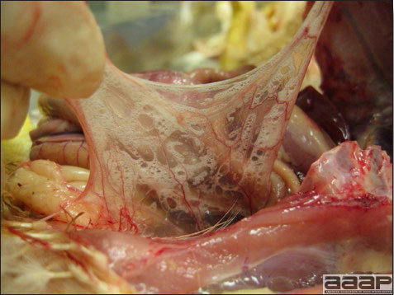
In birds of different ages, E.coli can cause severe infection of the upper or lower respiratory system through the nasal route or the trachea.
In cases of localised infection of the upper respiratory system, facial oedema and sinuses swelling can be presented and described as swollen head syndrome.
However, in case of lower respiratory infection, colibacillosis is characterized by the presence of fibrinous whitish yellow exudates in the air sacks and fibrinous pneumonia

Slide 11
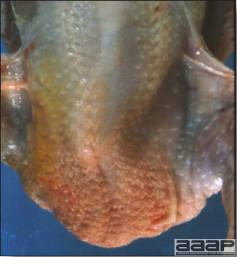
Another type of localized colibacillosis is cellulitis that is characterized by inflammation of the skin and presence of subcutaneous fibrinous exudates especially in broilers.

Slide 12
Coliform salpingitis/peritonitis/salpingoperitonitis (adult).
Inflammation of the oviduct caused by E. coli results in decreased egg production and sporadic mortality. The oviduct is distended with exudate ;that may be caseous and has a foul odor. No specific signs are noted but there may be an upright (penguin) posture.
It is one of the most common causes of mortality in commercial layer and breeder chickens and also affects other female birds, especially ducks, geese, and quail.
Accumulations of caseating exudate in the body cavity resemble coagulated yolk, which is the reason for the common name “egg peritonitis.” Yolk peritonitis is a mild to moderate diffuse peritonitis without exudate resembling coagulated yolk that results from free yolk in the body cavity..

Slide 13
Yolk peritonitis is usually associated with bursting atresia that occurs during acute ovarian regression.
Marked exudation, extensive inflammation, and positive cultures characterize coliform peritonitis and serve to distinguish it from yolk peritonitis

Slide 14
Acute septicemia
disease caused by E. coli resembles fowl typhoid and fowl cholera. Birds are in good flesh and have full crops suggesting acuteness of the disease. This can occur in young or mature birds. There are sudden deaths, and variable morbidity and mortality. Parenchymatous organs are swollen with congested pectoral muscles. Livers are green in color and may have small necrotic foci. There may be petechial hemorrhages, pericarditis, or peritonitis..

Slide 15
Coligranuloma (Hjärre’s disease) Signs vary in this uncommon disease of chickens and turkeys. Nodules (granulomas) occur along the intestinal tract, and mesentery, and in the liver

Slide 16
Synovitis and osteoarthritis Affected birds are lame or recumbent. There is swelling of one or more tendon sheaths or joints .
Synovitis and/or osteoarthritis are frequently a sequel to a systemic infection. With synovitis many birds will recover in about 1 week.
Osteoarthritis is a more severe and chronic condition where the joint is inflamed and the associated bone has osteomyelitis. These severe chronic infections make birds unwilling or unable to walk and necropsy findings often include dehydration and emaciation. Synovitis-arthritis may also be caused by reovirus, or species of Mycoplasma, Staphylococci, and Salmonella

Slide 17
DIAGNOSIS
Diagnosis of primary colibacillosis is based on the isolation and typing of a coliform into one of the serotypes recognized as pathogens.
tREATMENT
Numerous antimicrobials have been utilized for treatment. These have; neomycin, sulfa drugs and others but E. coli has developed resistance to many of these commonly used antimicrobials. Antibiotic sensitivity testing is therefore strongly suggested

